Slide 1
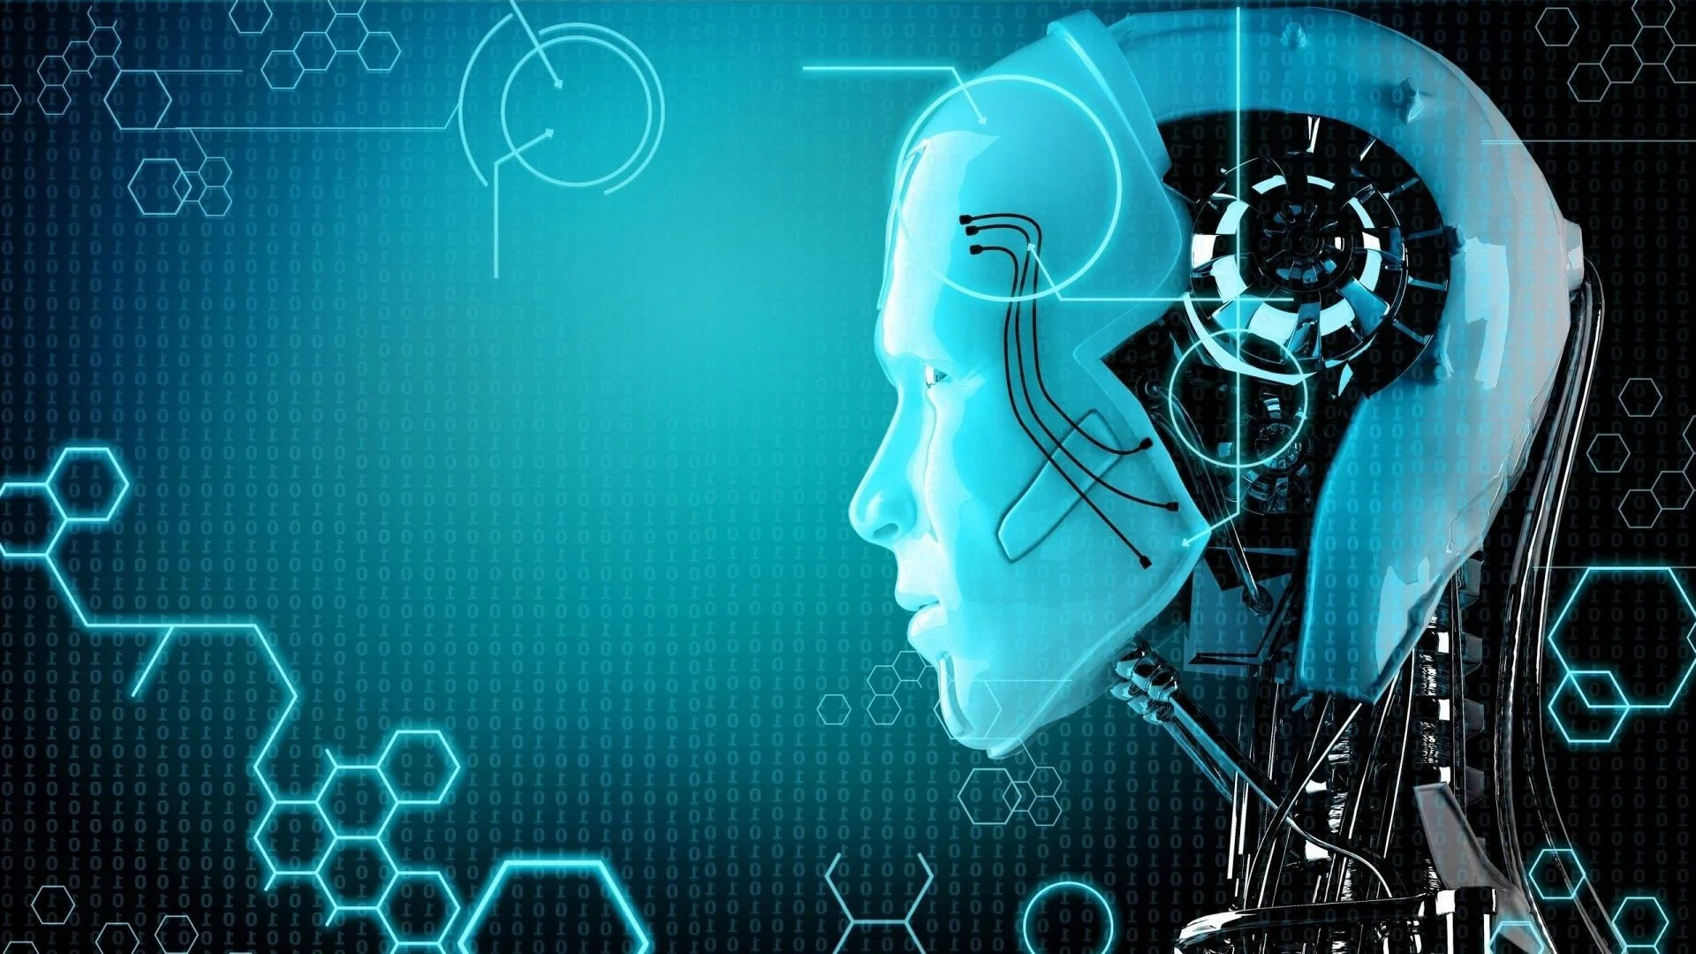
Artificial Intelligence Summer of Science 2022
Anurag Chaudhari
Mentor: Mohammad Taufeeque
IIT BOMBAY

Slide 2
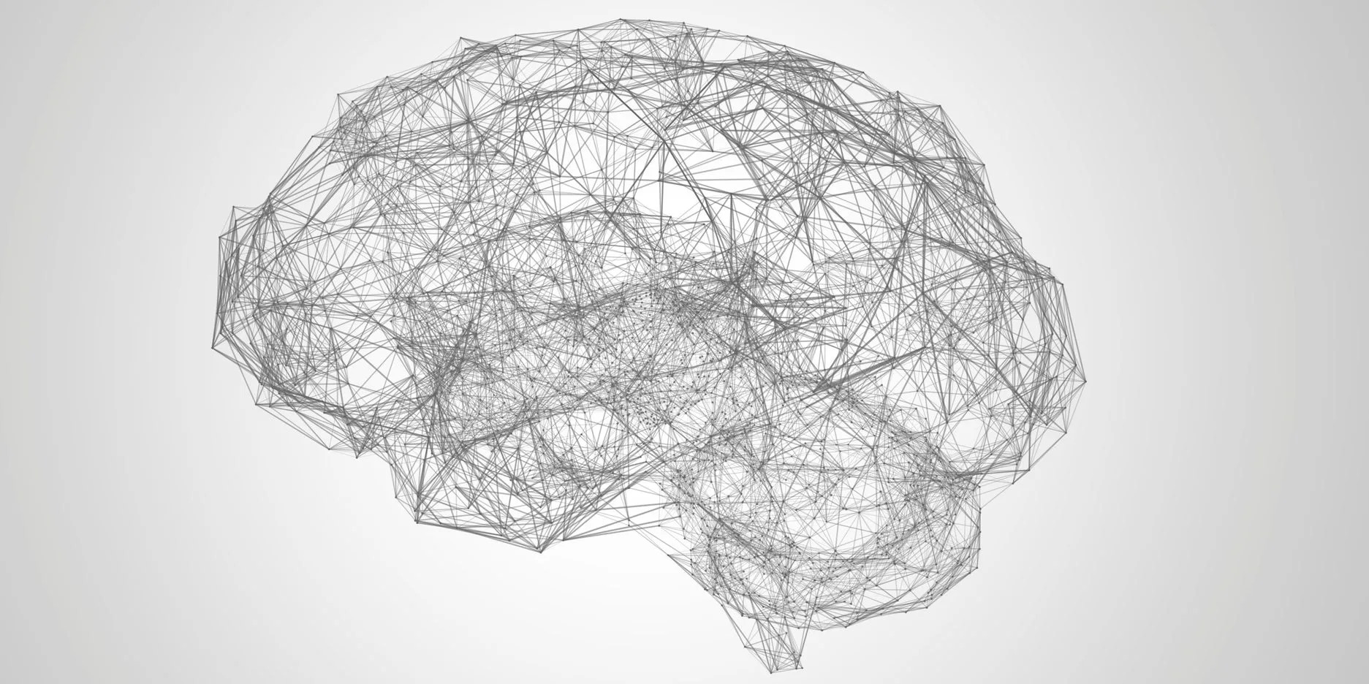
What is Artificial Intelligence?
Artificial intelligence is the simulation of human intelligence processes by machines, especially computer systems.
Specific applications of AI include expert systems, natural language processing, speech recognition and machine vision.
What is Machine Learning?
Arthur Samuel described it as: “the field of study that gives computers the ability to learn without being explicitly programmed.”
Tom Mitchell provides a more modern definition: “A computer program is said to learn from experience E with respect to some class of tasks T and performance measure P, if its performance at tasks in T, as measured by P, improves with experience E.”

Slide 3
In general, Machine Learning can be split into two broad classifications:
Supervised Learning
We know what our correct output should look like, having the idea that there is a relationship between the input and the output
Supervised learning problems are categorized into “regression” and “classification” problems
Unsupervised Learning
Allows to approach problems with little or no idea what results look like
May not necessarily know the effect of the variables in the data
No feedback based on the prediction results

Slide 4
What is Neural Networks?
Subset of machine learning and are at the heart of deep learning algorithms
Neural networks is a model inspired by how the brain works.
It is widely used today in many applications:
voice command interpretation in phone
digit recognition; eg. cheque deposit machines

Slide 5
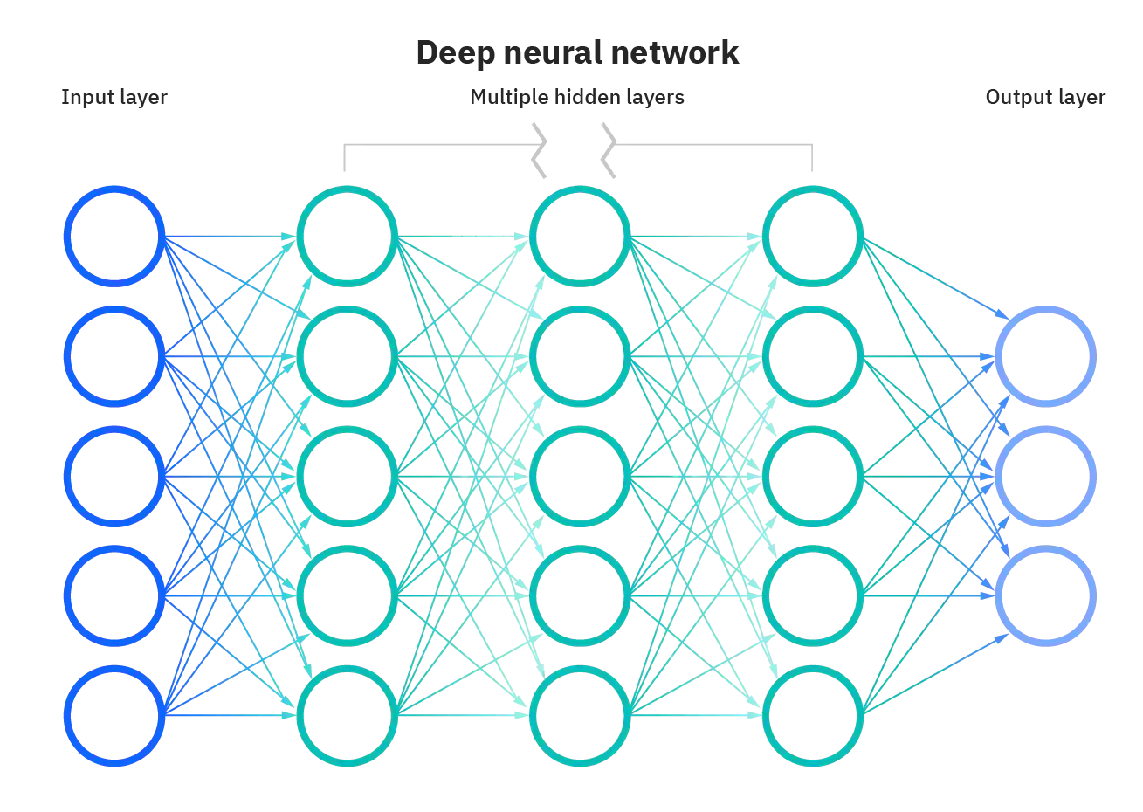

Each node contains an input layer, one or more hidden layers, and an output layer.
Each node is linear regression model, composed of input data, weights, a bias, and an output. The formula looks like this:
$$Z=Bias+\sum_{i=1}^{n}{w_{i}x_{i}}$$

Slide 6
Building a Digit Recognition Model
To get a practical experience and better understanding of Neural Networks
Digit Recognition model based on Neural Networks
Steps Involved:-
Load Data
Normalize and prepare Data
Construct Neural Network
Model selection
Testing analysis
Model deployment

Slide 7
How to reduce error?
Accuracy can be further increased by increasing number of epochs (training error should decrease)
Number of hidden layers can be increased
Different model compilers, optimizers, loss, metrics could be tried to reduce error
However, increasing epochs and hidden layers increases computational time

Slide 8

Thank you!
Maths & Physics Club, IIT Bombay for this opportunity
Mentor: Mohammad Taufeeque
Family
Prof. Andrew NG and Coursera for free to audit course

